Slide 1
The Assurence
of Salvation

Slide 2

Matt. 7:24-25
Notes:
Matthew 7:24-25
24 Therefore whosoever heareth these sayings of mine, and doeth them, I will liken him unto a wise man, which built his house upon a rock:
25 And the rain descended, and the floods came, and the winds blew, and beat upon that house; and it fell not: for it was founded upon a rock.

Slide 3
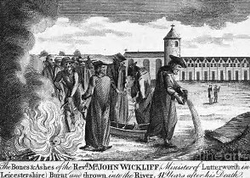
Notes:
John Wycliffe 1330 - 1384 the Morning star of Reformation

Slide 4
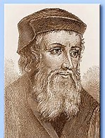

Slide 6
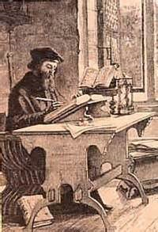

Slide 7
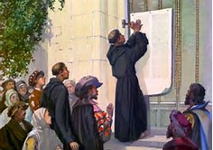

Slide 9
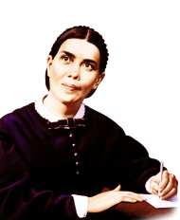

Slide 14


Slide 15
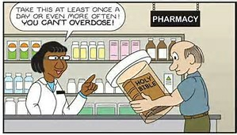

Slide 16



Slide 17
